Slide 1
TACOM
Data Management
Update
Updated 6/01/2012
FOUO

Slide 2
TOPICS
TWV Pilot Program
Preparation for Data Transmission Test
Data Transmission Test
Data Transmission observations
Data Transmission Assumptions and Calculations
On-going Data Management Program Refinement
Updated 6/01/2012
FOUO

Slide 3
Army ABCD Format
Files and Messages Agreement # 3
A-3 LOGSA will house Registry Information
Intent: The intent of this agreement is for each of the MACOMs to agree where the authoritative source of CBM parametric data will be housed. LOGSA is designated as the custodian of CBM+ data per AR 750-1. In this role, LOGSA provides mechanisms to load, validate, store, query and retrieve CBM+ data within a secure environment called the Common CBM+ Data Warehouse
Status: LOGSA has implemented a ARMY instance of the MIMOSA database schema and is populating it with data supplied by or as instructed by the various MACOMs.
To date, TACOM has provide LOGSA with data to populate approximately 26 MIMOSA tables.
Updated 6/01/2012
FOUO

Slide 4
TACOM TWV Pilot Program
TACOM is executing a CBM+ Tactical Wheeled Vehicles (TWV) Pilot Program to demonstrate the value of CBM+.
Within in the TWV Pilot, a contract has been awarded to QinetiQ to collect sensor data from 2000 TWV located around the world. TWV Pilot SOW meeting held 24 May 2012 at TACOM.
Updated 6/01/2012
FOUO

Slide 5
TACOM TWV Pilot Program
Contract Requirements
From a Data Management perspective, the contract calls for the contractor to
Instrument Digital Source Collectors (DSC) on 2000 Tactical Wheeled Vehicles (TWVs) specified by TACOM and collect data points available on either the J1708/J1587 or J1939 busses as specified by TACOM
Install GPS/Accelerometer/Orientation sensors on a subset of 500 TWVs and collect data points available as specified by TACOM
Provide DSC User Manual including how to install, operate, maintain, and configure the DSCs.
Using a Contractor laptop, pull data from each instrumented vehicle and transmit data to LOGSA once every two weeks formatted in the Army ABCD format and send the ABCD files to LOGSA every two weeks
Capture and report maintenance activities performed on the 2000 TWVs in an Excel Spreadsheet and forward that spreadsheet to LOGSA every two weeks
Provide both Unit and CBM+ Feedback Summary Reports
Analysis Processes and Techniques reports at the end of the period of performance.
Updated 6/01/2012
FOUO

Slide 6
TACOM TWV Pilot Program
Contract Data Transmission Options
The contract allows the contractor to send data collected to LOGSA using any of the technologies listed below:
  CD/DVD
  Email
  Secure File Transfer Protocol (SFTP)
  Other TACOM approved options (Data Sticks, Removable Hard drives, ETC)
TACOM’s preferred approach is SFTP
Updated 6/01/2012
FOUO

Slide 7
TACOM TWV Pilot Program
Vehicle Family / Model Breakdown
The Army currently identifies six families of TWVs. The families and model variants are defined by NIIN. A summary by model variant is listed in the table below. HMMWV’s are not part of the TWV Pilot.
Family # of Models/Variants
HMMWV 43
FMTV 122
HEMTT 81
HET 4
M915 49
PLS 17
Totals 316
Updated 6/01/2012
FOUO

Slide 8
TACOM TWV Pilot Program
Vehicle Model Listing
TACOM has identified specific model variants to be included in the TWV Pilot Program. Specific model/variants are subject to change as Unit Pre-briefs are conducted at the various locations.
Updated 6/01/2012
FOUO

Slide 9
TACOM TWV Pilot Program
Data Point Breakdown
TACOM initially identified the data to be monitored by platform family as shown in the table below. Approximately 135 total Measurement Locations have been identified for monitoring.
 | FMTVA1 | LHSA2/4 | HEMTTA2/4 | Line haul A3 | HET
Recorded Maintenance Events | ✓ | ✓ | ✓ | ✓ | ✓
Unit Identification | ✓ | ✓ | ✓ | ✓ | ✓
Vehicle Identification Info | ✓ | ✓ | ✓ | ✓ | ✓
GPS / Accelerometer | ✓ | ✓ | ✓ | ✓ | ✓
* Engine Speed | ✓ | ✓ | ✓ | ✓ | ✓
* Instantaneous Fuel Economy | ▪ | ✓ | ✓ | ✓
* Accelerometer Pedal Position | ✓ | ✓ | ✓ | ✓ | ✓
* Engine Load | ✓ | ✓ | ✓ | ✓ | ✓
* Road Speed – Used for Miles | ✓ | ✓ | ✓ | ✓
* Trans Output Shaft Speed | ▪ | ✓ | ✓ | ✓ | ✓
* Fuel Rate | ✓ | ✓ | ✓ | ✓ | ✓
* Transmission Range | ▪ | ✓ | ✓ | ✓ | ✓
* Transmission Oil Temperature | ▪ | ✓ | ✓ | ✓ | ✓
* Engine Oil Temperature | ✓ | ✓ | ▪ | ✓ | ✓
* Fuel Temperature | ✓ | ✓ | ▪ | ✓ | ✓
* Battery Potential Voltage | ✓ | ✓ | ✓ | ✓ | ✓
* Engine Coolant Temperature | ✓ | ✓ | ✓ | ✓ | ✓
* Air Inlet Temperature | ✓ | ✓ | ▪ | ✓
* Boost Pressure | ✓ | ✓ | ✓ | ✓ | ✓
* Engine Oil Pressure | ✓ | ✓ | ▪ | ✓ | ✓
* Output Torque | ✓ | ✓ | ▪ | ✓ | ✓
* Transmission Range Selected | ▪ | ✓ | ✓ | ✓ | ✓
* Injection Control Pressure | ▪ | ✓ | ✓ | ▪ | ▪
* Barometric Pressure | ✓ | ✓ | ▪ | ✓ | ✓
Updated 6/01/2012
FOUO

Slide 10
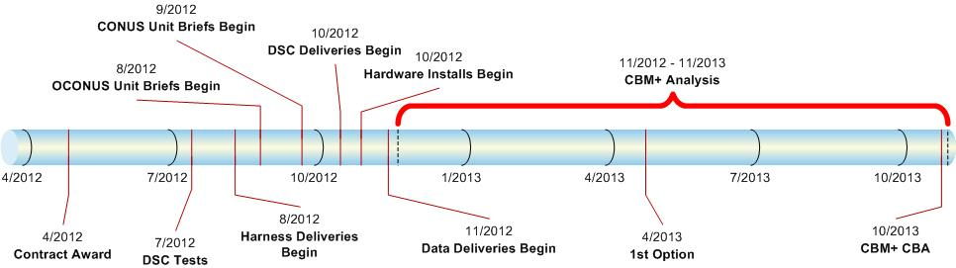
Conceptual TACOM CBM+ Pilot Program Roadmap
TARDEC and AMSAA Analysis Support
Partnerships in Execution, Analysis and Build
  FORSCOM G4 – Unit Coordination
  AMSAA - Program Development/Execution & Analysis
  PM TV – Program Development and Execution
  TYAD - DSC Harness build
  LOGSA – Data Storage and Management
  SED DISCoE - ABCD Standards Implementation
Industry Partnerships
  QinetiQ North America
  Penn State University ARL
  Control Point Corporation
3 External Sources for Data Analysis

Slide 11
Send Data to LOGSA
Overview
LOGSA is designated as the custodian of CBM+ data per AR 750-1. In this role, LOGSA provides mechanisms to load, validate, store, query and retrieve CBM+ data within a secure environment called the Common CBM+ Data Warehouse (CCBMDW).
LOGSA mechanisms include servers, software and:
Processes to post CBM+ data on a Data Collection Server
Processes to catalog CBM+ data files within the CCBMDW
Processes to query the CCBMDW and to download related CBM+ files
Processes to forward CBM+ files to another site called a Drop Server
Updated 6/01/2012
FOUO

Slide 12
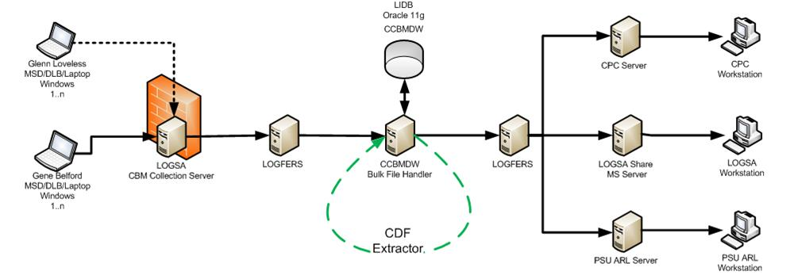
Send Data to LOGSA
CCBMDW Environment Overview
The LOGSA CCBMDW environment is depicted in the figure below. It allows non-GFE devices to post data onto a LOGSA server via a .com network and can forward files to external entities such as Penn State ARL and Control Point Corporation.
Post Data
Catalog and Retrieve Data
Forward Data
Management
&
Exception
Reports
User Queries
Web
FSR Laptop
Army Workstation
FSR Laptop
Updated 6/01/2012
FOUO

Slide 13
Send Data to LOGSA
MIMOSA Data Definitions
To establish the LOGSA CCBMDW environment for TACOM it was necessary to define Data for each of the MIMOSA tables listed below. This definition process was possible because TACOM is its own naming authority per an ABCD Best Practice agreement.
Data within these tables are used directly or indirectly in the ABCD MIMOSA “Tags” and these “Tags” cannot be populated without first populating these tables with TACOM data. TACOM personnel created the required data for each table and forwarded it to LOGSA and validated the results.
Asset
Blob_Data_Type
Data_Source
Data_Source_Type
Eng_Units
Eng_Units_Type
Eng_Study_Code
Eng_Study_Entry
Eng_Study_Type
Enterprise
Enterprise_type
Meas_Event
Meas_Location
Meas_Loc_Type
Manufacturer
Model
Model_Chr_Data
Segment
Site
Site_Database
Site_Type
Updated 6/01/2012
FOUO

Slide 14
Send Data to LOGSA
MIMOSA Key Tables
ABCD “Tags” require information from two key MIMOSA tables: 1) Site and 2) Meas_location. Other tables populated were required to support these two key tables.
The Site table includes information needed to identify each unique platform (by serial number). This table was populated by identifying all 316 TWV models/variants by name and NIIN and then running queries against other Army data to populate platform data into the Site table.
The Meas_Location table includes information that describes the parametric data being collected from each platform. This table was created by first identifying data available on the two busses (J1708/J1587 or J1939) by model. A team of SME’s reviewed the list, determined what data was actually available and then defined calculated values. GPS/Accelerometer/Orientation Meas_Location information was extracted from the M916 sample files. The results were forwarded on to LOGSA for loading into the appropriate tables.
Updated 6/01/2012
FOUO

Slide 15
Send Data to LOGSA
Data Collection Server
LOGSA provides a Data Collection Server on the LOGSA firewall that is available to both the .COM and .MIL networks. The server name is CS3.LOGSA.ARMY.MIL and can be accessed via a SFTP connection.
Access to the Data Collection Server is controlled by LOGSA security. Users needing access must submit a System Access Request (SAR) to LOGSA. If approved, LOGSA will provide the user both a UserID and Password (no CAC Card required) and will create a folder on the Data Collection Server where the user has write access.
The process for creating a SAR is available on the TACOM ILSC CBM “Data Management” SharePoint portal in a document titled “CCBMDW Data Transfer Setup”. Only users with CAC cards can create a SAR request.
Updated 6/01/2012
FOUO

Slide 16
Send Data to LOGSA
Data Cataloging
A LOGSA application known as the “Bulk File Handler” (BFH) processes each file posted to the Data Collection Server. For each file types known to the BFH, the file is opened and contents cataloged based on rules provided for the file type. File types not recognized by the BFH are stored and an exception is logged.
File types currently recognized by the BFH include:
Ext File Type
abcd Army Bulk CBM Data
cdf Common Data Format
skt CDF skeleton table
Xls Excel Spreadsheet
xml XML document
zip Compressed Data File
Updated 6/01/2012
FOUO

Slide 17
Send Data to LOGSA
Data Drop Server
LOGSA has the ability to forward CBM+ files to a remote site(s) called a Drop Server. These Drop Servers may be on either a .COM or .MIL network but require a static IP address.
Owners of each Drop Server must create a UserID and Password for LOGSA, create a folder that the LOGSA UserID has write access to and provide this information back to LOGSA.
Each MACOM wanting LOGSA to forward CBM+ data to a Drop Server must provide rules to LOGSA describing which data is to be forwarded and to which Drop Server. Each file may be sent to more than one Drop Server.
Updated 6/01/2012
FOUO

Slide 18
Send Data to LOGSA
Web Based Queries
LOGSA is currently developing a web based application that will allow users to query CBM+ data from the CCBMDW catalog. The query will allow the user to choose from any of the items cataloged and will provide a listing of criteria meeting the selection and an option to download related files.
The Web Based Query tool is currently being built and tested within the LOGSA development environment.
When complete, access to the query application will require a LOGSA SAR to be submitted. LOGSA has not currently defined this SAR process.
Updated 6/01/2012
FOUO

Slide 19
Send Data to LOGSA
Reporting
LOGSA is currently developing both Management and Exception reports for CCBMDW data.
TACOM Requirements for both types of reports are required before these reports can be completed.
LOGSA has not currently established processes for distributing either Management or Exception reports.
Updated 6/01/2012
FOUO

Slide 20
Send Data to LOGSA
File Naming Standards
In order to reduce the new development and sustainment efforts for the Bulk File Handler (BFH) in the CCBMDW, LOGSA has undertaken the effort to develop a set of guidelines for the naming of files to be submitted to LOGSA for storage in the CCBMDW.
The intent of these guidelines is to provide a reasonable and flexible set of conventions for file names so that any file reaching the CCBMDW can be easily stored and retrieved without worrying about duplicate file names.
These guidelines are documented in a draft document titled “LOGSA-CCBMDW-CBM-001 LOGSA Standard CBM File Naming Guidelines” Revision 0.06 dated April 5, 2011 on the TACOM ILSC CBM Data Management SharePoint portal.
Updated 6/01/2012
FOUO

Slide 21
LOGSA Data Transmission Test
Overview
A major concern for TACOM is the ability to move CBM data from the field to the Common CBM Data Warehouse (CCBMDW) and the ability to retrieve this data for analysis purposes.
To better understand these capabilities, a Data Transmission Test was planned and conducted during the week of April 8, 2012.
The goal of this test was to demonstragd how CBM+ data collected for the TWV Pilot will migrate from the field to the CCBMDW and then retrieved for analysis.
The test was planned and conducted using the LOGSA production environment.
Updated 6/01/2012
FOUO

Slide 22
LOGSA Data Transmission Test
Test Environment
The environment for the Data Transmission Test is depicted in the figure below:
  LOGSA setup a Data Collection Server on the LOGSA firewall (available to the .COM network
  Glenn Loveless’ CPC laptop was configured to connect to the LOGSA Data Collection server using a Verizon Air Card
  Data Drop servers were created at both CPC and Penn State URL
  LOGFERs and the Bulk File Handler were running in a LOGSA Production Environment and connected to both Data Collection and Data Drop servers
Updated 6/01/2012
FOUO

Slide 23
LOGSA Data Transmission Test
Security Setup
  Access to the LOGSA Data Collection server is only available via a Secure File Transfer Protocol (SFTP).
Prior to the test,
  Processes to request user IDs and passwords required to access the Data Collection Server were created, documented and tested
  Using these processes, a User ID and Password was requested and created for Glenn Loveless
  LOGSA configured LOGFERs to monitor Glenn Loveless’ user folders on the Data Collection Server once per hour
  LOGSA user IDs and Passwords were created on the Data Drop Servers at both CPC and Penn State ARL
  LOGSA configured LOGFERs to log onto and transfer files to both the CPC and Penn State ARL Data Drop Servers
Updated 6/01/2012
FOUO

Slide 24
LOGSA Data Transmission Test
Test Data Set-up
  Prior to the test,
  The Updated M916 ABCD files were reviewed and a set of 44 files were copied into a test folder
  These 44 files represented a two week period between 12-Jun-2010 and 26-Jun-2010 for a single M916 platform (1FULATCG27PX52156)
  A single Excel Spreadsheet was created to represent a two week maintenance history spreadsheet
  The total size of the 44 files and the spreadsheet was 262 MB
  Each file was compressed using GZIP level 9
  All files conformed to LOGSA file naming standards
Updated 6/01/2012
FOUO

Slide 25
LOGSA Data Transmission Test
Software Setup
Prior to the test,
  The Army recommended SFTP software named “Putty” was installed on Glenn Loveless’ CPC owned laptop
  The CPC standard SFTP software named “Filezilla” was installed on Glenn Loveless’ CPC owned laptop
Updated 6/01/2012
FOUO

Slide 26
LOGSA Data Transmission Test
Pre-Test Activities
Using the test environment:
  The SFTP logon script and file transfer scripts were written and tested
  A single ABCD test file was uploaded using the Putty SFTP
  A single ABCD test file with no data was uploaded. LOGSA correctly identified the error and logged the data exception
  A single ABCD test file with invalid MIMOSA tags was uploaded. LOGSA correctly identified the “bad” tag and logged the data exception.
  The 44 ABCD test files and the maintenance history spreadsheet were uploaded.
  LOGSA demonstrated that the 44 ABCD files were successfully cataloged by executing a series of SQL queries manually
Updated 6/01/2012
FOUO

Slide 27
LOGSA Data Transmission Test
Demonstration Test
A formal Data Transmission Test was witnessed by Jason Duncan (TACOM) and George Theos (CPC)
During this test, Glenn Loveless used a CPC laptop and Putty to demonstrate:
  The SFTP logon script
  The 44 ABCD test files and the maintenance history spreadsheet being uploaded to the Data collection Server
LOGSA displayed Glenn Loveless’ folder on the Data Collection Server that showed files arriving and then disappearing as LOGFERs moved the files to the CCBMDW Bulk File Handler (only once)
Updated 6/01/2012
FOUO

Slide 28
LOGSA Data Transmission Test
Post Test Activities
After the formal Data Transmission Test was complete, additional tests were performed including uploading of multiple files using Glenn Loveless’ CPC laptop and Filezilla software to demonstrate:
Uploading of multiple files
Transferring of files to CPC and Penn State Data Drop Servers
Various Data Exceptions
Confirmation that files were transferred to both CPC and Pen State ARL Data Drop Servers
Updated 6/01/2012
FOUO

Slide 29
LOGSA Data Transmission Test
Transmission Test Results Summary
Files transmitted were collected by LOGFERs and then moved to the CCBMDW Bulk File Handler program which loaded them into the CCBMDW
A subset of these files were transferred to a Penn State ARL Data Drop Server (and in later tests to a CPC Data Drop Server) based on a set of Business Rules. No visual confirmation of this file transfer was demonstrated during the test.
LOGSA demonstrated that the ABCD files were successfully loaded and cataloged in the CCBMDW by executing a series of SQL queries manually
Updated 6/01/2012
FOUO

Slide 30
LOGSA Data Transmission Test
Observations: Transmission Time
The file transfer process was slow, taking about 45 seconds to move each MB of data. The full set of 45 files (262 MB) took over 4 hrs to transmit.
The Verizon Air Car used in this test used 4G technologies (approximately 120 KB/second) and is as fast as most wireless technologies available today.
Updated 6/01/2012
FOUO

Slide 31
LOGSA Data Transmission Test
Observations: Transmission Failure
During the test, the Verizon Air Card lost connectivity and the file transfer process had to be restarted.
For files still on the Data Collection Server, the SFTP program prompted the user to skip or replace the existing file
For files that had already been processed by LOGFERS, the files were re-transmitted resulting in
  Duplicate files within the CCBMDW
  Exceptions being noted with the CCBMDW
  Increase in the overall file transmission time
Updated 6/01/2012
FOUO

Slide 32
LOGSA Data Transmission Test
Observations: SFTP Application
The process to log onto the Data Collection Server and to transfer files required too many steps and the possibility for the user to make too may mistakes navigating between directories.
PuTTY commands are “DOS” like and require advanced skills. Some mistakes were made by Glenn during the test.
Note: Any data placed into an incorrect directory will not be processed by LOGFERs and potentially lost
Updated 6/01/2012
FOUO

Slide 33
LOGSA Data Transmission Test
Observations: ABCD Test Data
Of the 51 zVariables transmitted, 24 were associated with either GPS or the Orientation Pack. These 24 zVariables contained over 80% of the of data being transmitted.
Some zVariable data did not change often. For example, while the vehicle was at rest, the same data was recorded over and over. (i.e. speed_mph = 0)
The precision of some zVariable seemed excessive. For example, the zVariables “mean_BatPotV ”, “mean_EngOilT ” were accurate to 6 decimal places. “speed_mph” and “EngineSpeed ” were both accurate to 2 decimal places.
Some calculated data was very large. For example, the zVariables “Acc_x_comp” is calculated from other data. The single zVariable required more disk space than any of the other single variable
Each ABCD file was a Single-File CDF compressed at the file level using compression="GZIP.9”
Updated 6/01/2012
FOUO

Slide 34
LOGSA Data Transmission Test
Observations: Excel Spreadsheet
The excel spreadsheet was successfully received and processed by LOGSA.
Cataloging was base solely on the file name and was limited to only characters contained within the file name
Using the file name limits what LOGSA can catalog about this file
Updated 6/01/2012
FOUO

Slide 35
Assumptions and Calculations
Vehicle Mission Times
For the purpose of calculating data volumes, it is assumed that
Each TWV vehicle will perform a 3 hr mission per day
There will be 14 missions per two week period
Type A platforms include J1708/J1587, J1939 and GPS/Accelerometer/Orientation data
Type B platforms include J1708/J1587 and J1939 data only
Updated 6/01/2012
FOUO

Slide 36
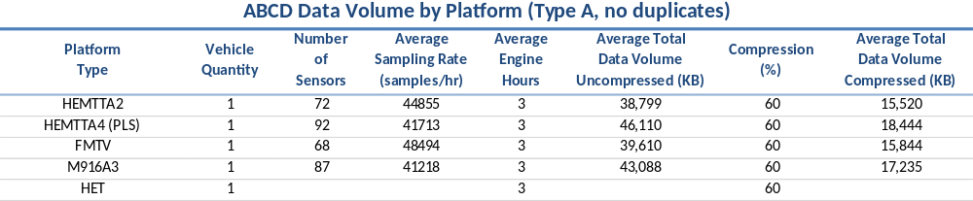
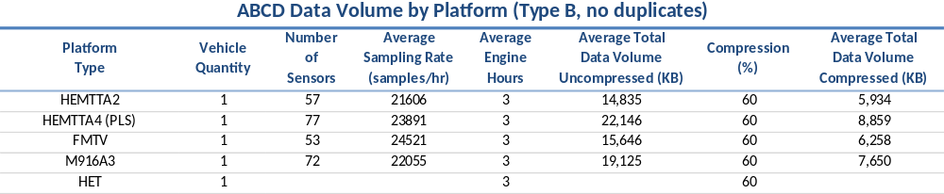
Assumptions and Calculations
Data Estimates
Per Vehicle Per Mission
Note: Average Mission length is 3 hrs
Type A platforms include J1708/J1587 and J1939 and GPS/Accelerometer/Orientation
Type B platforms include J1708/J1587 and J1939 data only
Updated 6/01/2012
FOUO

Slide 37
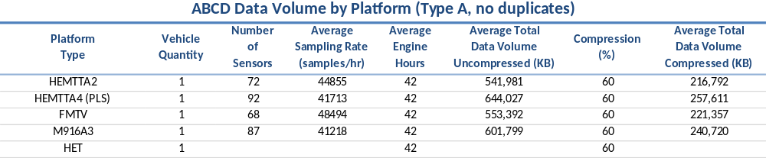
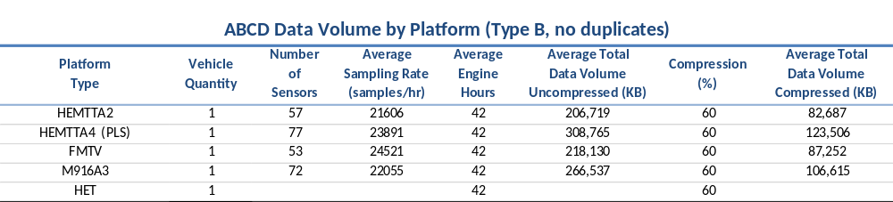
Assumptions and Calculations
Data Estimates
Per Vehicle Per Period
Note: Period is 14 days
Updated 6/01/2012
FOUO

Slide 38
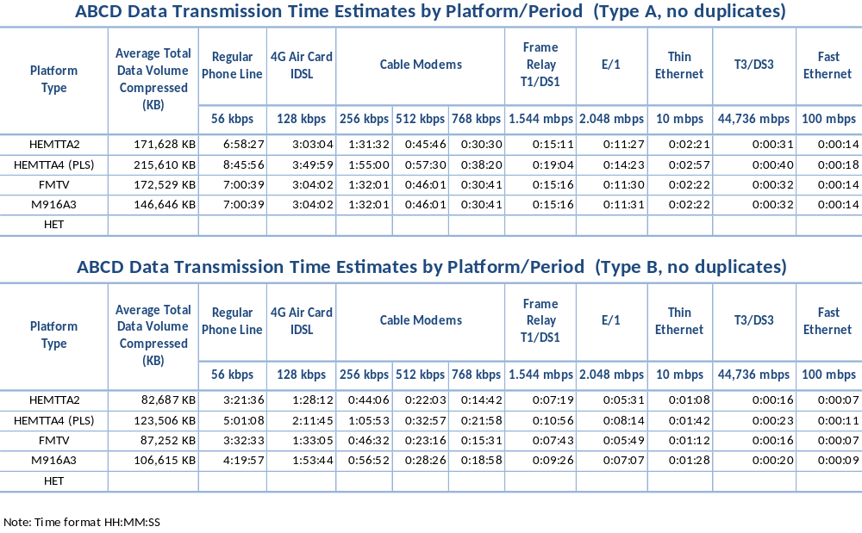
Assumptions and Calculations
Data Transmission Time Estimates
Per Vehicle Per Period
Updated 6/01/2012
FOUO

Slide 39
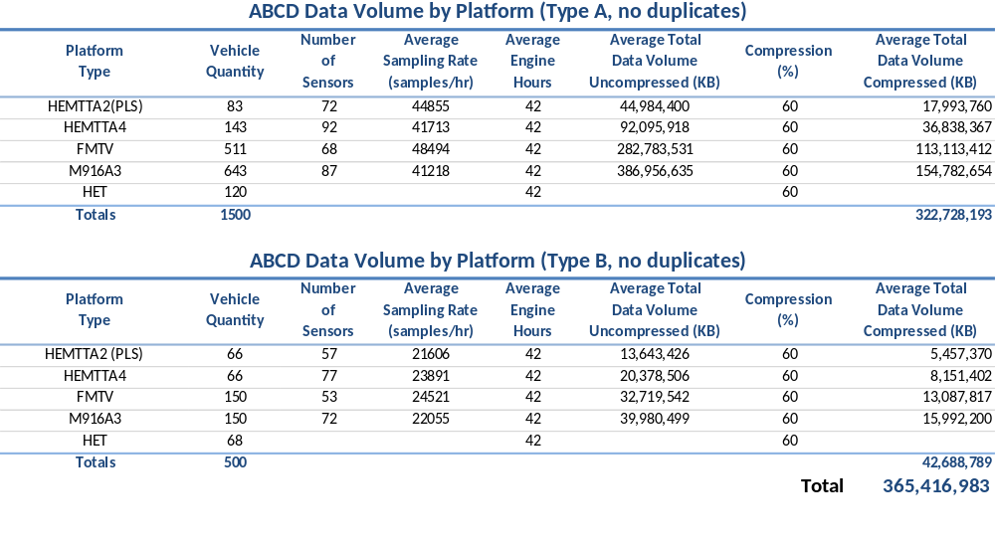
Assumptions and Calculations
Total Data Volume Estimates
Per Period
Note: Distribution of Vehicle Quantities between families is still an estimate
Updated 6/01/2012
FOUO

Slide 40
On-Going Work
LOGSA: MIMOSA Data
TACOM personnel will continue to define TACOM Data and will work with LOGSA personnel populate the MIMOSA tables.
TACOM personnel will continue to work with LOGSA personnel to define and implement processes to maintain and/or synchronize MIMOSA data with the authoritative data sources.
Updated 6/01/2012
FOUO

Slide 41
On-Going Work
Variable Definitions
TACOM personnel continue to work with the TWV community to define, review and agree on measurement locations including:
Variable Name
Variable Description
Sampling Units
Data Type
Precision
Sampling Frequency
Sampling Frequency Units
ECU Address
To date, some 516 possible measurement locations have been defined (across all families) and 236 have to been loaded into the MIMOSA Meas_Locations table by LOGSA. Review of this effort continues.
Updated 6/01/2012
FOUO

Slide 42
On-Going Work
Define Calculated Values
TACOM personnel continue to document TACOM’s requirements for data calculations including rules and determine which can be performed most efficiently at the platform, by LOGSA , or by the Analyst.
Calculated values may be performed on/at the platform and if so, must be included in the Meas_Locations table. On/At platform calculated values may increase file size and thus increase file transmission times.
Calculated values may be performed at the enterprise and if so, will be cataloged within the CCBMDW but may not require an entry in the Meas_Location table. At enterprise calculated values may decrease file size and thus decrease file transmission times but will increase processing requirements at LOGSA.
Updated 6/01/2012
FOUO

Slide 43
On-Going Work
Calculated Values Requirements
Listed below are sample calculation requirements:
Usage:
Miles per Gallon
Total Fuel Consumed
Idle Fuel Consumed
Metrics:
Total Miles per Mission
Total Hours per Mission
Total Idle Hours per Mission
Updated 6/01/2012
FOUO

Slide 44
On-Going Work
Define “User Defined” tags
ABCD Best Practices allow for User Defined “Tags”. These are items that can be included in a ABCD file but are not required.
TACOM personnel continue to define User Defined “Tag” requirements.
Examples of User Defined Tags include:
  Engine Serial Number
  Transmission Serial Number
  Configuration File Name
  Mission Duration (hours)
  -Mission Length (miles)
  Data Source Address (ECU info)
Updated 6/01/2012
FOUO

Slide 45
On-Going Work
Define Processes to Configure DSC
Define and document the processes that TACOM will use to notify the TWV Pilot Vendor of both initial and updates to the DSC configuration.
Configuration includes:
  ABCD formatting rules (Best Practices)
  MIMOSA platform identification information
  MIMOSA Measurement Location information
    Variable Names
    Measurement frequencies and units (1 hz)
    Measurement precision (0, 0.0, 0.00000)
    Measurement unit standards (i.e. report distance in miles)
  Requirements for User Defined Tags (LVL090)
  Calculation Rules
  Validation Process (i.e. Vendor reports vehicle serial number
  Written instructions for TWV Pilot Vendor
Updated 6/01/2012
FOUO

Slide 46
On-Going Work
TACOM CCBMDW Cataloging Rules
Continue to define TACOM rules for cataloging data within the CCBMDW and work with LOGSA personnel to implement each rule.
Catalog rule examples include:
Log ABCD Vehicle (model, serial number, odometer reading) Information
Log ABCD File Date (recording start/end times, mission length)
Log each of the Variables and related MIMOSA “tags” contained within each ABCD file
Updated 6/01/2012
FOUO

Slide 47
On-Going Work
TACOM CCBMDW Cataloging Rules
Global Attributes
G1. Catalog the name and value for each gAttribute in the Global Attributes section
G2. Catalog the (Original) ABCD File Name
G3. Catalog the file size in bytes
Variable
V1. Catalog the name of each zVairable within the zVariable section
V2. Catalog the “Attribute Name” and “Entry Data” for each zVariable in the Variables section
Updated 6/01/2012
FOUO

Slide 48
On-Going Work
Define CCBMDW Calculation Requirements
Define and provide LOGSA with TACOM requirements for data calculations performed at the enterprise and then work with LOGSA personnel to implement each calculation requirement.
Enterprise calculation examples include:
Mission length (hrs and/or miles)
Bytes of data collected per mission hour
Average ABCD file size
Average ABCD data collected per Mission Hour
Number of Variables per file
Data Inconsistencies (e.g. file name does not match file user tag)
Updated 6/01/2012
FOUO

Slide 49
On-Going Work
Define CCBMDB Management Reports
Define TACOM requirements for CCBMDW Management reports and work with LOGSA personnel to implement.
Examples of Management reports include:
Number files received per day
Average file size / Storage Space projections
Average mission length (hrs and/or miles)
Summary and Details of Vehicles reporting data
Summary and Details of Vehicles with missing data
Summary and Details of Data Exceptions
Updated 6/01/2012
FOUO

Slide 50
On-Going Work
CCBMDB Exception Reporting Requirements
Define TACOM requirements for CCBMDW Exception reports and work with LOGSA personnel to implement both the reporting and processes to resolve exceptions.
Exception reporting and processing examples include:
Reports notifying TACOM of bad, incomplete, corrupt and missing data
  Bad Data – TAGs not found within MIMOSA tables
  Incomplete – Required TAGs not provided or All sequence files not provided
  Corrupt – CBM file (ABCD or Excel) cannot be opened
  Missing data – Data not received for one or more vehicles
TACOM roles and responsibilities to monitor or resolve exception issues
  Who identifies root causes
  Who resolves
TACOM processes for correcting bad, incomplete, corrupt or missing data
  Who will corrections be implemented
Updated 6/01/2012
FOUO

Slide 51
On-Going Work
Define CCBMDW Data Forwarding Rules
Define TACOM rules for forwarding CBM+ Data received at the CCMBDW to other entities and then work with LOGSA personnel to implement these data forwarding rules. In particular, what data values causes files to be forwarded to one or more entity.
Other entities include:
Control Point Corporation
Penn State ARL
TARDEC
AMSAA
Pilot Vendor
Updated 6/01/2012
FOUO

Slide 52
On-Going Work
Define Data Reduction Techniques
The time required to transmit the volume of data used during the Data Transmission test maybe too long to meet the requirements of the TWV Pilot.
TACOM and the TWV Community need to continue to evaluate options to reduce the volume of data collected on/at the platform, thus reducing transmission times. This effort includes documenting options, test results and working with TWV Pilot Vendor to implement approved reduction techniques.
Examples include:
Reducing sampling frequency
Reducing data precision (float vs integer)
Reporting data only on-change where appropriate
Evaluating CDF data compression techniques
Minimizing use of calculated value in ABCD files
Updated 6/01/2012
FOUO

Slide 53
On-Going Work
Data Reduction Techniques
CDF Data Compression Algorithms
CDF supports four compression algorithms at both file and Variable Level. Compression can be applied at either the file (global) or variable levels. Variable level compression must be set before variable data can be added.
The four compression algorithms are listed below. Descriptions of each type can be found in the NASA CDF User’s Guide.
    Huffman
    Adaptive Huffman
    Run-Length Encoding
    GZIP (Levels 1 – 9)
There are tradeoffs between each type of compression pertaining to file size, file creation time, and file transmission time. Therefore the on-going work is to determine/recommend the optimal approach.
Updated 6/01/2012
FOUO
53

Slide 54
On-Going Work
Data Reduction Techniques
CDF File Level Data Compression Findings
A sample ABCD file (M916_1FULATCGX7PX52136_2009-03-02_0102.cdf”) was stored uncompressed and then with each of four CDF compression techniques applied at the file level (GZIP at both level 5 and level 9) . The file size and % compression results were noted and results shown below.
Compression Technique File Size (bytes) % of Uncompressed
No Compression 256,110,305 100%
RLE Compression 244,650,851 95.5%
Huffman Compression 226,747,809 88.5%
Adaptive Huffman Compression 180,137,943 70.3%
GZIP Level 5 Compression 101,080,285 39.4%
GZIP Level 9 Compression 98,769,365 38.5%
GZIP Compression provided the best file level compression option. GZIP levels between 1 and 9 allow for a trade-off between compression and execution speed. TACOM needs to decide on a GZIP level based on a need for compression (effects data transmission and storage) or for speed in opening or closing a CDF file.
Updated 6/01/2012
FOUO
54

Slide 55
On-Going Work
Data Reduction Techniques
CDF Variable Level Data Compression Findings
A sample ABCD file (M916_1FULATCGX7PX52136_2009-04-28_0425_-195.cdf”) containing a single variable (Acc_x_comp ) was stored uncompressed and then with each of four CDF compression techniques applied at the file level (GZIP at both level 5 and level 9). The file size and % compression results were noted and results shown below.
Compression Technique File Size (bytes) % of Uncompressed
No Compression 21,010 100%
RLE Compression 20,992 99.1%
Huffman Compression %
Adaptive Huffman Compression %
GZIP Level 5 Compression 18,625 88.4%
GZIP Level 9 Compression 18,625 88.4%
GZIP Compression again provided the best file level compression option. For this particular variable, data values changed between most observations leaving little room for compression (no repeating patterns).
Updated 6/01/2012
FOUO

Slide 56
On-Going Work
Data Reduction Techniques
CDF Variable Precision Findings
CDF supports a variety of data types. All data types are based on an 8-bit byte.
CBM Parametric data is primarily numeric. CDF supports the following integer, numeric and character data types:
CDF_BYTE 1-byte, signed integer (0, 1)
CDF_INT1 1-byte, signed integer (+/- 0 thru 127)
CDF_UINT1 1-byte, unsigned integer (0 thru 256)
CDF_INT2 2-byte, signed integer (+/- 0 thru 65,536)
CDF_UINT2 2-byte, unsigned integer (0 thru 131,072)
CDF_INT4 4-byte, signed integer (+/- Big)
CDF_UINT4 4-byte, unsigned integer (+/- Big*2 )
CDF_FLOAT
CDF_REAL
CDF_CHAR
Updated 6/01/2012
FOUO

Slide 57
On-Going Work
Data Reduction Techniques
Variable Precision Data Compression Findings
A sample ABCD file (M916_1FULATCGX7PX52136_2009-04-28_0425_-191.cdf”) containing a single variable (Speed MPH ) containing 23,160 records was stored in both a Float (i.e. 0.0447388) and Integer CDF_INT2 (i.e. 0) format and the results noted. Both files were compressed using GZIP level 9.
The file size and % compression results were noted and results shown below.
Data Format File Size (bytes) % of Uncompressed
Float 40,970
Integer 8,192 20%
In this example, converting “Speed MPH” from Float to Integer in this example resulted in about and 80% reduction in file size.
Updated 6/01/2012
FOUO

Slide 58
On-Going Work
Define LOGSA SARs Process
The TWV Pilot Vendor will need access to the LOGSA Data Collection Server. This access requires that a SAR be created and submitted to LOGSA. Only personnel with a CAC cards and access to the LOGSA web site have the authority to submit a SAR.
TACOM will need to help the TWV Vendor coordinate this effort. To do this, TACOM will need to work with LOGSA personnel to:
Define and document the process by which the TWV Pilot Vendor will request access to the LOGSA Collection Server (LOGSA SAR).
Define and document TACOM’s roles and responsibilities related to TWV Pilot Vendor SARs request.
Updated 6/01/2012
FOUO

Slide 59
On-Going Work
Simplify File Transfer Process
The TWV vendor will need to transfer multiple files from each platform once every two weeks. The steps currently defined to move data to the Data Collection Server are cumbersome and prone to errors.
TACOM, LOGSA and TWV vendor need to look for options to simplify the SFTP process to minimize user involvement and minimize possibilities for mistakes:
Examples include:
Utilizing scripts to transfer data
Evaluate SFTP applications with simpler User Interfaces
Updated 6/01/2012
FOUO

Slide 60
On-Going Work
Reduce Data Transmission Failure Risk
During the Data Transmission Test, the Verizon Air Card being used lost connectivity and the file transfer process had to be restarted. For files that had already been processed by LOGFERS, the files were re-transmitted resulting in
  Duplicate files within the CCBMDW
  Exceptions being noted with the CCBMDW
  Increase in the overall file transmission time
  An uncertainty by LOGSA that all files had been received
On simple solution to minimize any data transmission failure effects is to “ZIP” the files before sending. Under this scenario, LOGFERS could not process the file until it is closed by the sending application and no files can be lost. The impact to LOGSA is the need to “Un-ZIP” a zipped file… but this file type is already recognized and should be handled.
Note: Zipping ABCD files will not reduce the overall size as these are already zipped.
Updated 6/01/2012
FOUO

Slide 61
On-Going Work
Define Maintenance Data Spreadsheet
The TWV Pilot Vendor is required to supply a maintenance spreadsheet per platform once every two weeks. For this data to provide value, the content must be formatted such that it can be queried electronically.
TACOM, LOGSA and TWV Vendor personnel need to define and document a standard format and structure for maintenance data spreadsheets such that LOGSA can properly catalog the contents.
LOGSA personnel need to develop processes to catalog key spreadsheet information within the CCBMDW.
Updated 6/01/2012
FOUO

Slide 62
Questions?
Updated 6/01/2012
FOUO

